Slide 1
Dynamically Generating Documents with Adobe Document Generation API
Raymond Camden | Senior Developer Evangelist

Slide 2

Who am I?
Raymond Camden
Developer Evangelist for the Document Services Team
Blogging at raymondcamden.com
Tweeting at @raymondcamden
Getting too many emails at jedimaster@adobe.com

Slide 3
TLDR: Adobe Document Generation API
Use Microsoft Word as a template…
Use your data…
Create dynamic, personalized, magical PDFs (or Word docs)

Slide 4
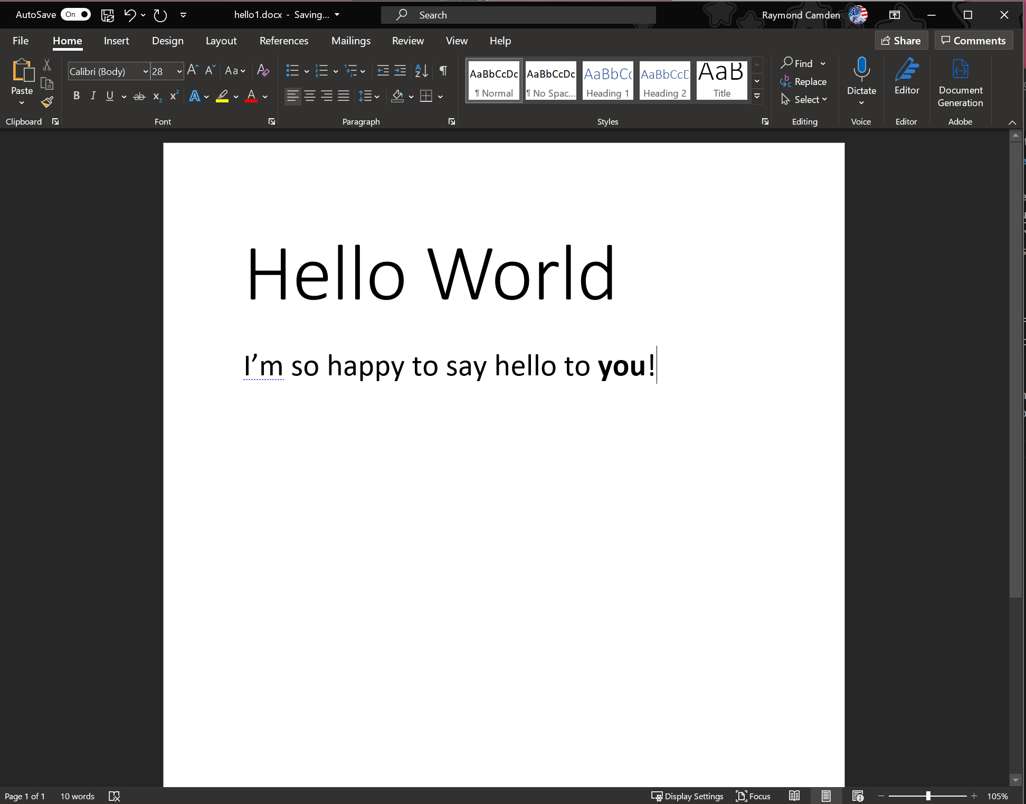
Just the Pictures Version…

Slide 5
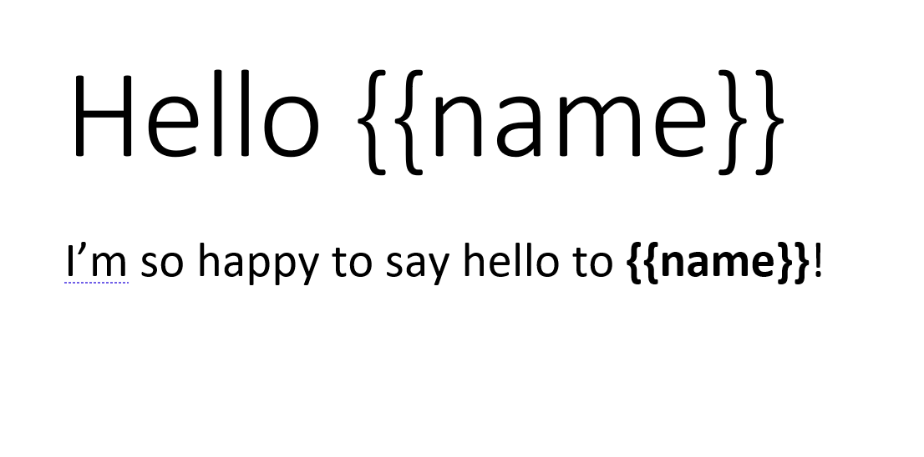
Just the Pictures Version…

Slide 6

Just the Pictures Version…
Totally not approved by branding…

Slide 7
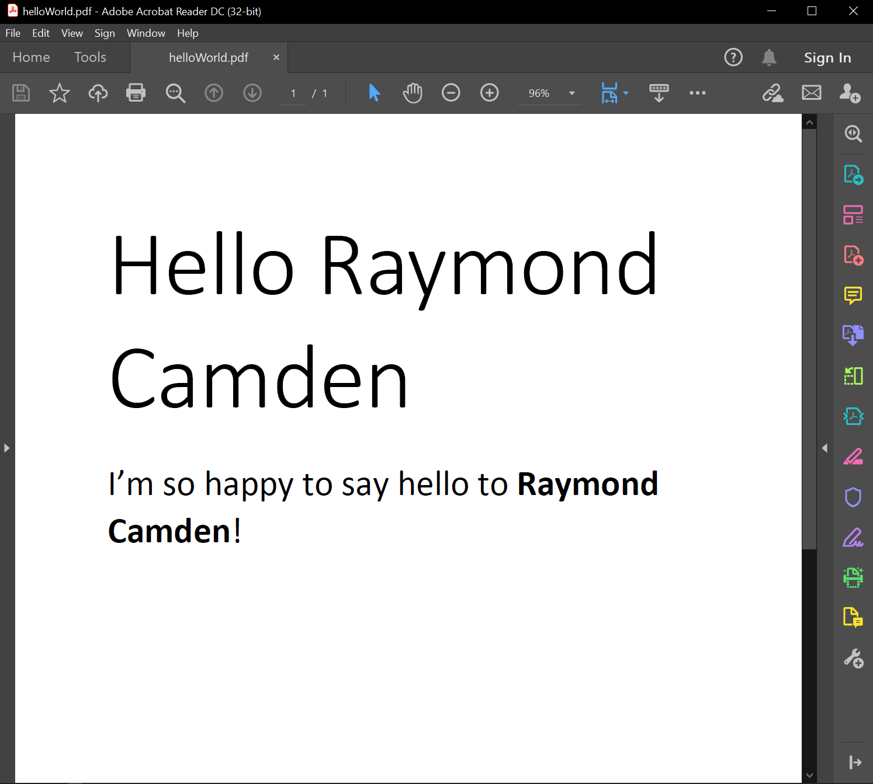
Just the Pictures Version…

Slide 8
Document Generation - Details
Part of Adobe PDF Services API
API call takes your Word doc and your data
Merges your data into the Word doc
Returns the dynamic PDF (or Word) file

Slide 9
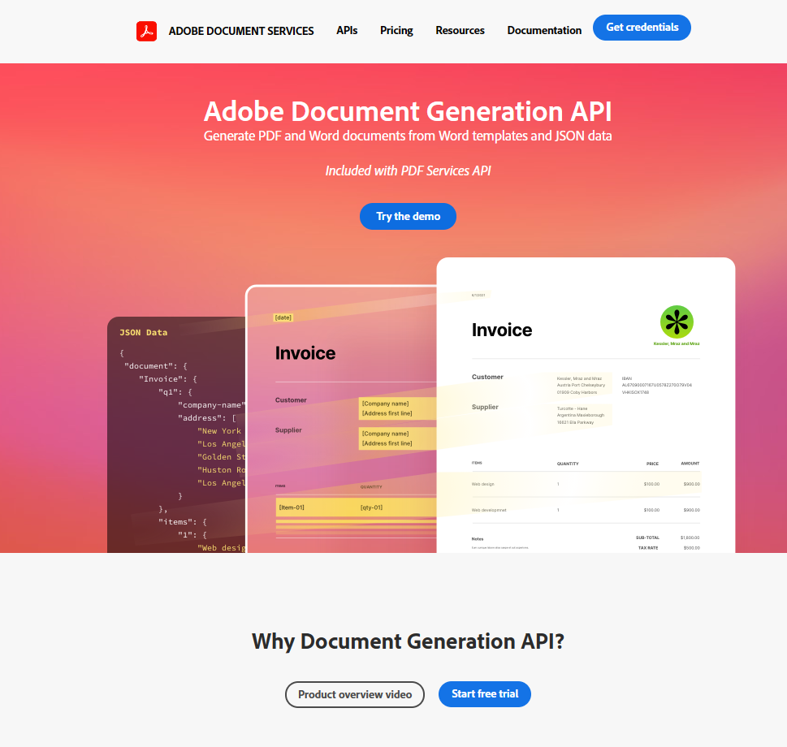
Before You Start
Sign up for a free trial
Get your credentials
Get your SDK (Node, .NET, Java)

Slide 10
Write Your Code
Point the code at the Word template
Get your data
Call the API
Save the result
In theory, never touch your code again

Slide 11
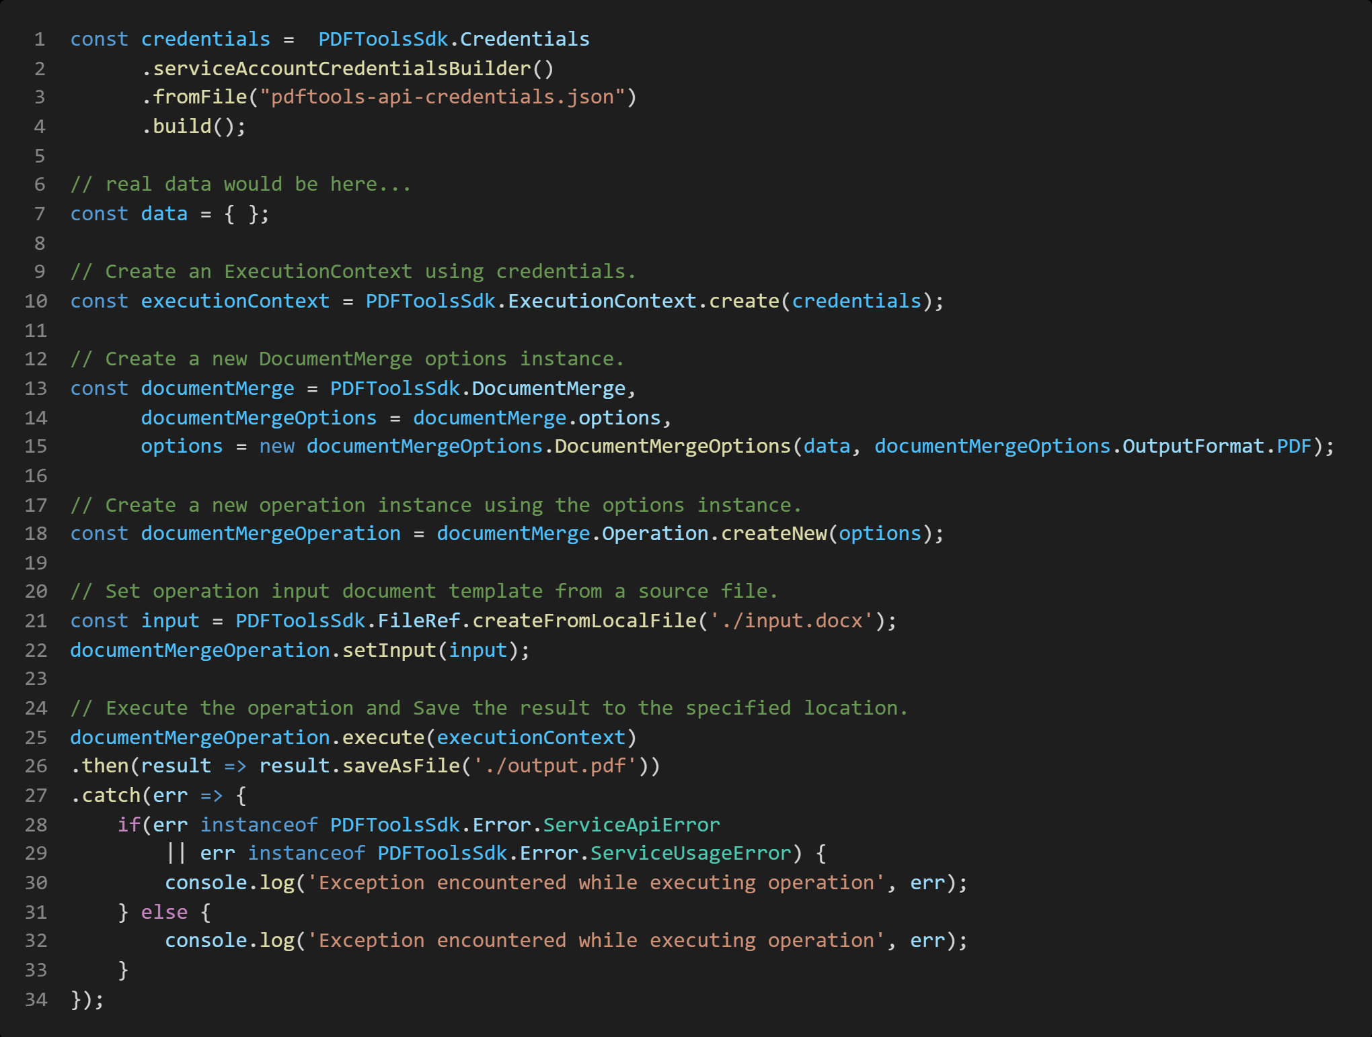

Slide 12
The Word Template
It’s a regular Word template
With “tokens” that represent variables and logic
Authoring toolkit to help you:
Generate tags and logic
Test without writing code

Slide 13
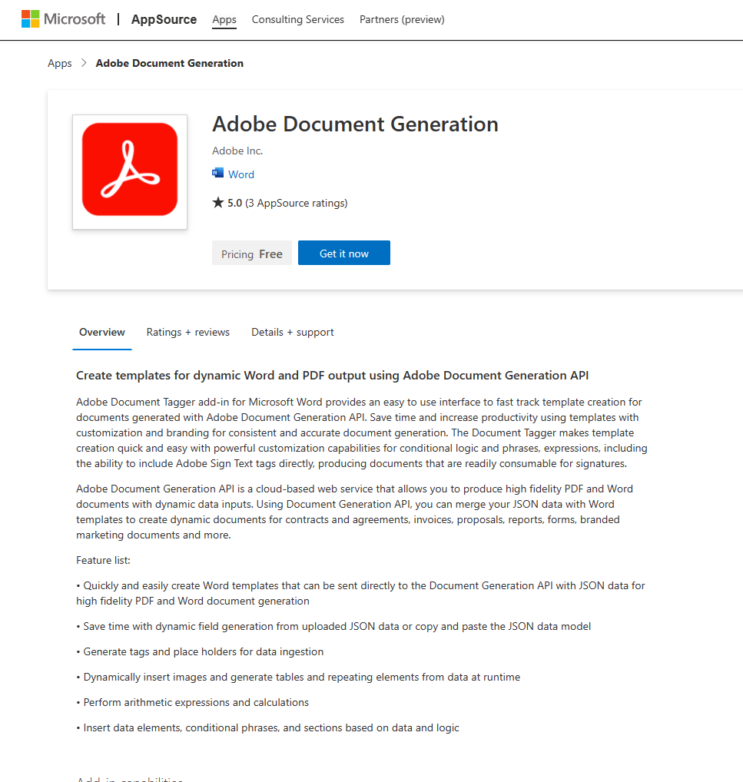
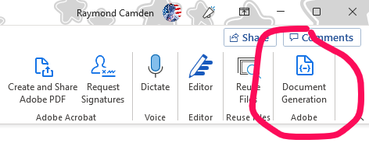
https://appsource.microsoft.com/en-us/product/office/WA200002654

Slide 14

Demo
Notes:
Show the word template, show test1.js. Then show the tagger.
Replace the variables – do not do the conditiona

Slide 15
The Tagging Language
Based on JSONata (https://jsonata.org/)
Supports simple variable replacements
Supports conditionals
Supports looping (bulleted lists and tables)
Supports dynamic images
Formatting support (see JSONata docs)

Slide 16
Demo
Notes:
In this demo, I edit the word template to add a conditional for salary.
I demonstrate a list of responsibilities
Maybe a table of benefits?

Slide 17
More…
Sign tags / integration
Image support via Base64
Notes:
Need to add more here

Slide 18
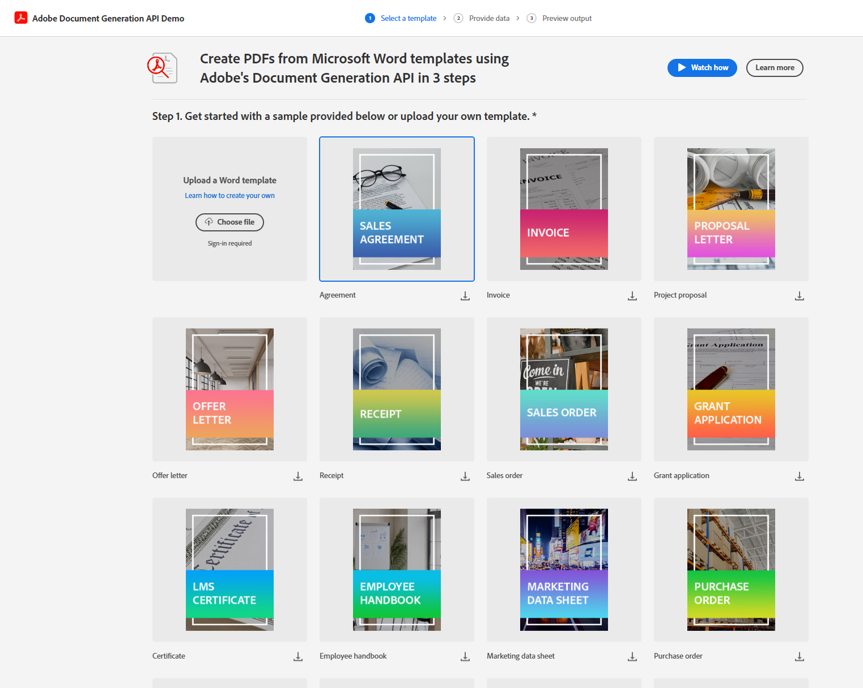
The Playground

Slide 19
























Adobe Document Services: End-to-end digital document lifecycle solutions
CREATE
SIGN
TRANSFORM
PUBLISH
EXTRACT
Document Generation API
Adobe Sign API
PDF Services API
PDF Embed API
PDF Extract API
FREE
Dynamically generate PDF and Word documents based on JSON data.
Send and capture legally-compliant e-signatures and capture web forms.
Transform PDFs such create, combine, and export to formats such as Word and other formats.
Embed PDF viewing experiences into your web apps and get analytics on your content.
Unlock data inside of PDFs and transform into JSON data.
Generate Word or PDF
Capture e-signatures
Create
Combine
Client-side rendering
AI-powered structure analysis
Conditional sections
Identity verification
Split
Export
Customizable viewing modes
Table and image extraction
Dynamic tables and lists
Embedded web forms
OCR
Protect
Comments and annotations
JSON
{;}
Data provides as JSON
Dynamic images
Send in bulk
Compress
Reorder
Analytics events
Adobe Sign-ready
Insert
Linearize
Notes:
Adobe Document Services APIs are entirely cloud-based, easy to use and deploy across different parts of a document lifecycle.
It brings some of the tools that you may be familiar with from our first-party apps as well as provides services uniquely available through API.
And we make these available through REST APIs as well as SDKs in a variety of languages.
So let’s talk about them a bit more.

Slide 20

Learn more here at Adobe Developers Live
CREATE
SIGN
TRANSFORM
PUBLISH
EXTRACT
Document Generation API
Adobe Sign API
PDF Services API
PDF Embed API
PDF Extract API
FREE
Dynamically generate PDF and Word documents based on JSON data.
Send and capture legally-compliant e-signatures and capture web forms.
Transform PDFs such create, combine, and export to formats such as Word and other formats.
Embed PDF viewing experiences into your web apps and get analytics on your content.
Unlock data inside of PDFs and transform into JSON data.
S305 - Dynamically generating documents with Adobe Document Generation API
Oct. 5th 1:00 PM – 1:30 PM
S304: Generating documents and capturing e-signatures in your apps using Adobe Sign API
Oct. 5th 10:15 AM – 10:45 AM
S302: Introduction to
Adobe PDF Services API
Oct. 4th 11:30 AM — 12:00 PM
S301: Wrangle PDFs on the web like a pro
Oct. 4th 11:30 AM — 12:00 PM
S303: Parsing PDF: As easy as working with JSON data with PDF Extract API
Oct 4th 1:00 PM – 1:30 PM
Notes:
Adobe Document Services APIs are entirely cloud-based, easy to use and deploy across different parts of a document lifecycle.
It brings some of the tools that you may be familiar with from our first-party apps as well as provides services uniquely available through API.
And we make these available through REST APIs as well as SDKs in a variety of languages.
So let’s talk about them a bit more.

Slide 21

Any questions?

